Slide 1

CSE-214: Numerical Methods Sessional
Md. Jakaria
Lecturer
Dept. of CSE, MIST

Slide 2
Motivation
Most Engineering analysis problems involve:
The development of a mathematical model (Theoretical Model) to represent all the important characteristics of the physical system
The derivation of the governing equations of the model by applying physical laws such as Newton’s law of motion, conservation of mass, conservation of momentum and conservation of energy
Solution of the governing equations (Mathematical Problem)
Interpretation of the solution.
Depending on the system being used, the governing equations may be a set of linear and non linear algebraic equations, a set of transcendal equations, a set of ordinary or partial differential equations, or an equation involving integrals or derivatives.
CSE 214: Numerical Methods Sessional

Slide 3
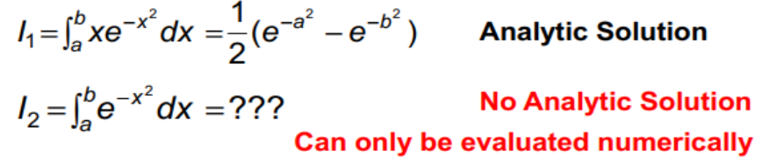
Motivation
Solution of governing equations may or may not be able to find in analytical form. Analytical solutions denote exact solutions that can be used to study the behavior of the system with varying properties.
Numerical solutions are those that can not be expressed in the form of mathematical expressions.
CSE 214: Numerical Methods Sessional

Slide 4
Introduction
Noncomputer Methods:
Solutions were derived for some problems using analytical, or exact, methods. However, analytical solutions can be derived for only a limited class of problems.
Graphical solutions were used to characterize the behavior of systems. But, graphical solutions (without the aid of computers) are extremely tedious and awkward to implement.
Calculators and slide rules were used to implement numerical methods manually. Again, Manual calculations are slow and tedious.
CSE 214: Numerical Methods Sessional

Slide 5
Introduction
Numerical methods are techniques by which mathematical problems are formulated so that they can be solved with arithmetic operations.
Numerical methods are capable of handling large systems of equations, nonlinearities, and complicated geometries that are often impossible to solve analytically.
The intelligent use of computer programs is often predicated on knowledge of basic theory underlying the methods.
Many problems cannot be approached using commercially available computer programs, so if you are adept of programming , you can design your own programs to solve problems.
Numerical methods provide a alternative perspective of mathematics
CSE 214: Numerical Methods Sessional

Slide 6
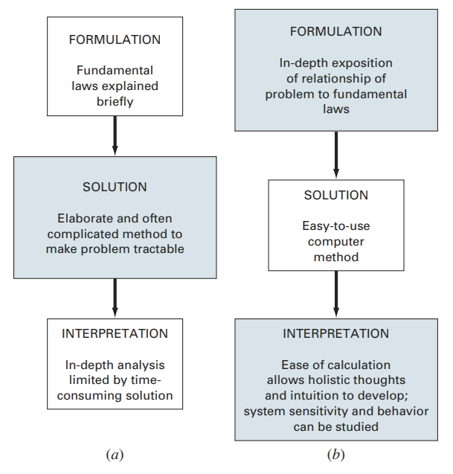
Introduction
FIGURE PT1.1
The three phases of engineering problem solving in
(a) The pre-computer and
(b) The computer era.
The sizes of the boxes indicate the level of emphasis directed toward each phase. Computers facilitate the implementation of solution techniques and thus allow more emphasis to be placed on the creative aspects of problem formulation and interpretation of results.
CSE 214: Numerical Methods Sessional

Slide 7
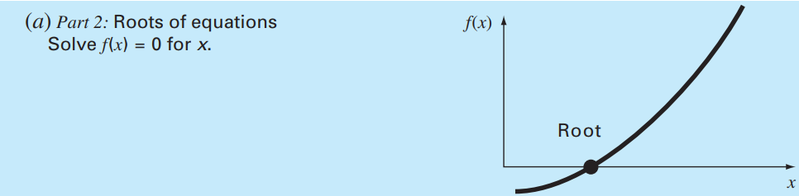
Mathematical Background
Roots of Equations: These problems are concerned with the value of a variable or a parameter that satisfies a single nonlinear equation.
CSE 214: Numerical Methods Sessional

Slide 8
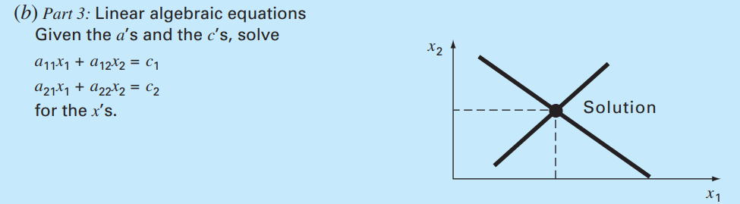
Mathematical Background
2. Systems of Linear Algebraic Equations: These problems are concerned a set of values is sought that simultaneously satisfies a set of linear algebraic equations.
CSE 214: Numerical Methods Sessional

Slide 9
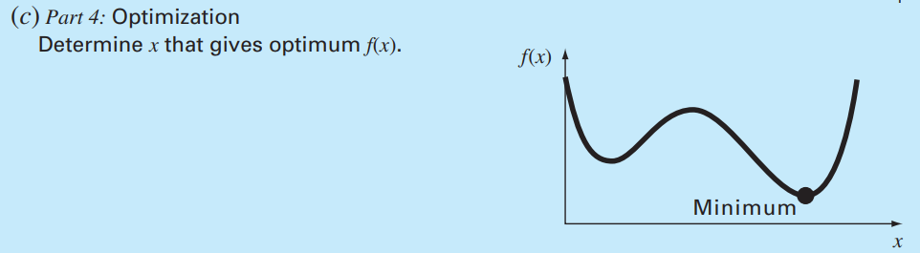
Mathematical Background
3. Optimization: These problems involve determining a value or values of an independent variable that correspond to a “best” or optimal value of a function.
CSE 214: Numerical Methods Sessional

Slide 10
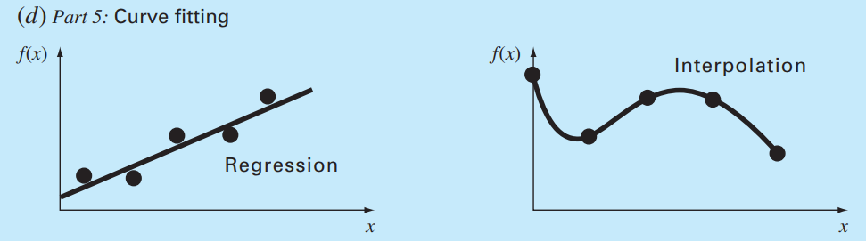
Mathematical Background
4. Curve Fitting: You will often have occasion to fit curves to data points.
Regression is employed where there is a significant degree of error associated with the data. The strategy is to derive a single curve that represents the general trend of the data without necessarily matching any individual points.
Interpolation is used where the objective is to determine intermediate values between relatively error-free data points. The strategy is to fit a curve directly through the data points and use the curve to predict the intermediate values.
CSE 214: Numerical Methods Sessional

Slide 11
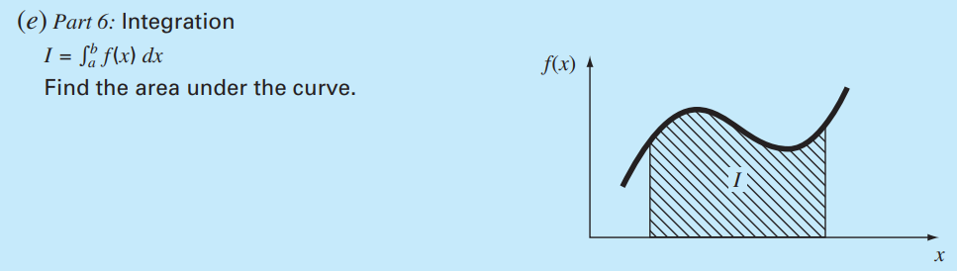
Mathematical Background
5. Integration: As depicted, a physical interpretation of numerical integration is the determination of the area under a curve.
CSE 214: Numerical Methods Sessional

Slide 12
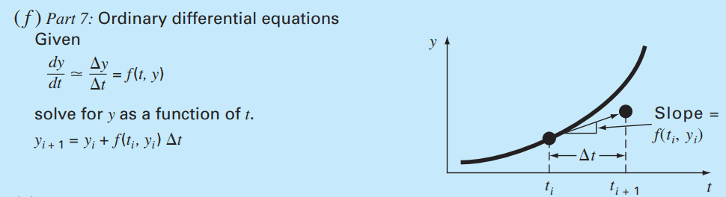
Mathematical Background
6. Ordinary Differential Equations: Many physical laws are couched in terms of the rate of change of a quantity rather than the magnitude of the quantity itself. Ex., population-forecasting models (rate of change of population).
CSE 214: Numerical Methods Sessional

Slide 13
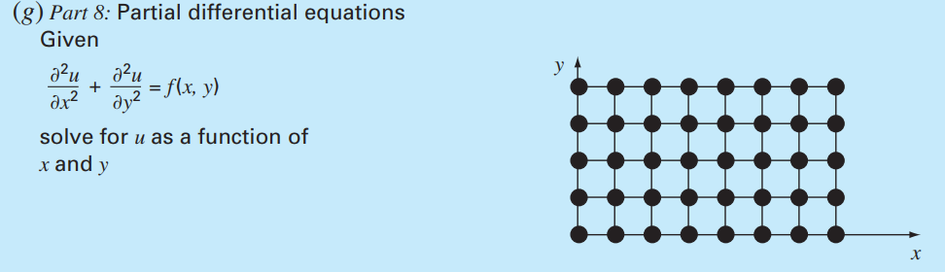
Mathematical Background
7. Partial Differential Equations: Partial differential equations are used to characterize engineering systems where the behavior of a physical quantity is couched in terms of its rate of change with respect to two or more independent variables. Example include the steady-state distribution of temperature on a heated plate (two spatial dimensions).
CSE 214: Numerical Methods Sessional

Slide 14
Engineering Problem Solving
Knowledge and understanding are prerequisites for the effective implementation of any tool.
Although computers have great potential utility, they are practically useless without a fundamental understanding of how engineering systems work.
Most engineering problem solving employs the two-pronged approach of empiricism and theoretical analysis
CSE 214: Numerical Methods Sessional

Slide 15
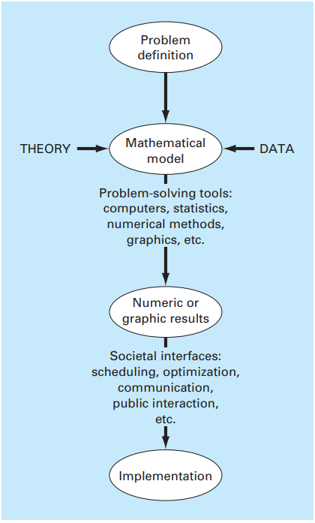
Engineering Problem Solving
FIGURE 1.1 The engineering problem solving process.
CSE 214: Numerical Methods Sessional

Slide 16

Mathematical Modeling
A mathematical model can be broadly defined as a formulation or equation that expresses the essential features of a physical system or process in mathematical terms.
In a very general sense, it can be represented as a functional relationship of the form
CSE 214: Numerical Methods Sessional

Slide 17
Mathematical Modeling
Dependent variable is a characteristic that reflects the behavior of the system
Independent variables are usually dimensions, such as time and space, along which the system’s behavior is being determined
Parameters are reflective of the system’s properties or composition
Forcing functions are external influences acting upon the system
CSE 214: Numerical Methods Sessional

Slide 18
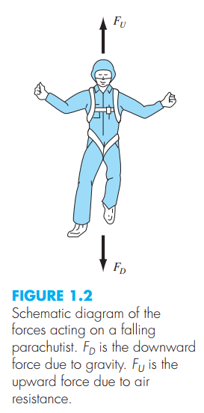

Mathematical Modeling Example
$$F=ma$$
$$a= \frac{F}{m}$$
$$\frac{dv}{dt}= \frac{F}{m}$$
$$F=F_{D}+F_{U}$$
$$F_{D}=mg$$
$$F_{U}=−cv$$
$$\frac{dv}{dt}= \frac{mg−cv}{m}$$
$$\frac{dv}{dt}=g −\frac{c}{m}v$$
CSE 214: Numerical Methods Sessional

Slide 19
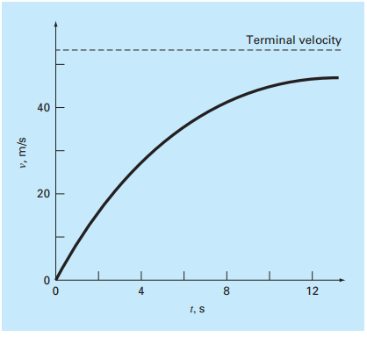
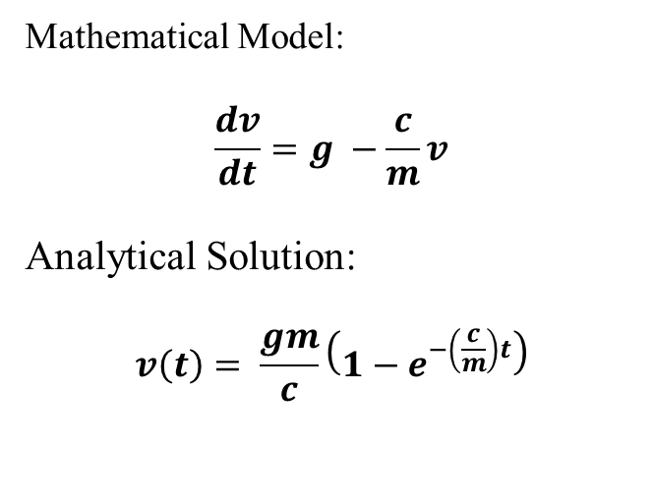
Mathematical Modeling Example
Mathematical Model:
$$\frac{dv}{dt}=g −\frac{c}{m}v$$
Analytical Solution:
$$v\left(t\right)= \frac{gm}{c}\left(1−e^{−\left(\frac{c}{m}\right)t}\right)$$
CSE 214: Numerical Methods Sessional

Slide 20
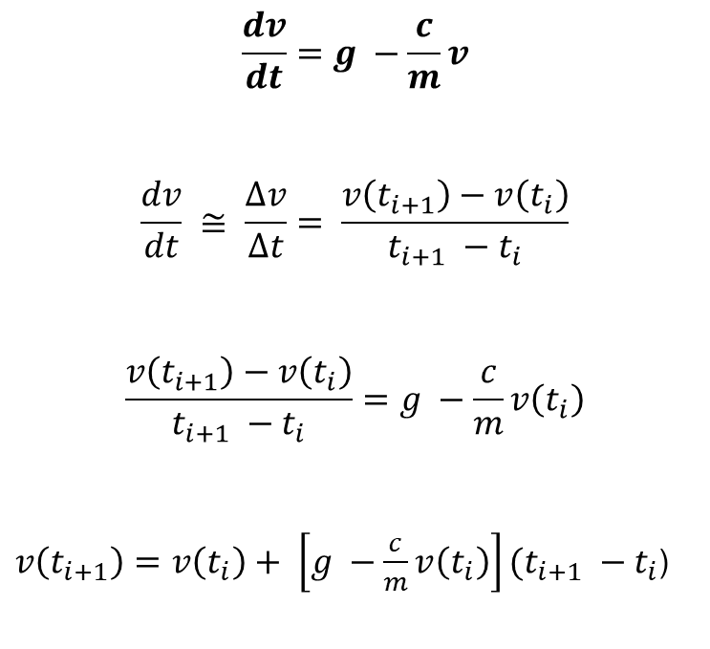
Mathematical Modeling Example
$$\frac{dv}{dt}=g −\frac{c}{m}v$$
$$\frac{dv}{dt} ≅ \frac{∆v}{∆t}= \frac{v\left(t_{i+1}\right)−v\left(t_{i}\right)}{t_{i+1} −t_{i}}$$
$$\frac{v\left(t_{i+1}\right)−v\left(t_{i}\right)}{t_{i+1} −t_{i}}=g −\frac{c}{m}v\left(t_{i}\right)$$
$v\left(t_{i+1}\right)=v\left(t_{i}\right)+ \left[g −\frac{c}{m}v\left(t_{i}\right)\right](t_{i+1} −t_{i}$)
CSE 214: Numerical Methods Sessional

Slide 21
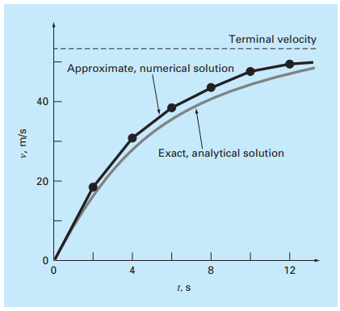
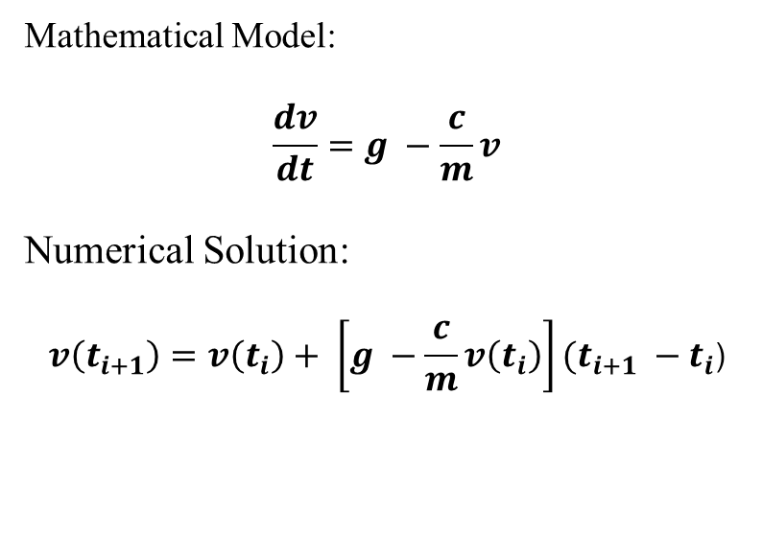
Mathematical Modeling Example
Mathematical Model:
$$\frac{dv}{dt}=g −\frac{c}{m}v$$
Numerical Solution:
$$v\left(t_{i+1}\right)=v\left(t_{i}\right)+ \left[g −\frac{c}{m}v\left(t_{i}\right)\right](t_{i+1} −t_{i}\text{)}$$
CSE 214: Numerical Methods Sessional

Slide 22
Approximation & Error
Floating Point Arithmetic
Fractional quantities are typically represented in computers using floating point format
This approach is similar to scientific notation
Example, fixed point number 17.542 is the same as the floating point number .17542×10² which is often displayed as .17542e2
Another example, -.004428 is same as -.4428×10⁻²
CSE 214: Numerical Methods Sessional

Slide 23
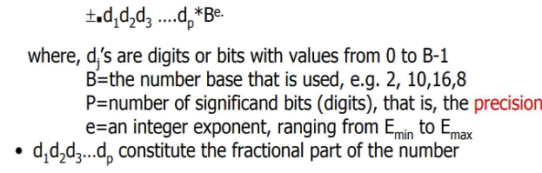
Approximation & Error
Floating Point Arithmetic
General form of floating-point number in Computers:
CSE 214: Numerical Methods Sessional

Slide 24
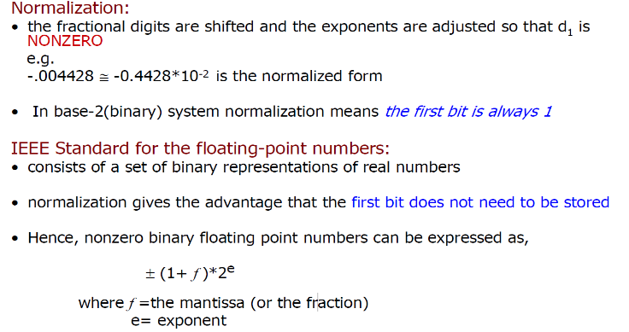
Approximation & Error
Floating Point Arithmetic
CSE 214: Numerical Methods Sessional

Slide 25
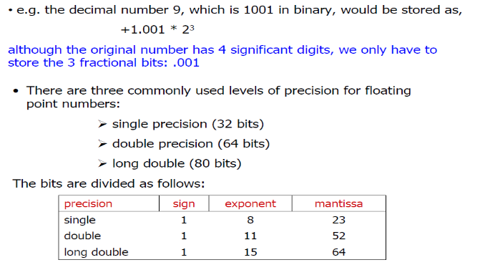
Approximation & Error
Floating Point Arithmetic
CSE 214: Numerical Methods Sessional

Slide 26
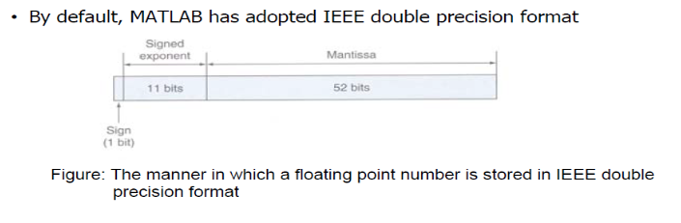
Approximation & Error
Floating Point Arithmetic
CSE 214: Numerical Methods Sessional

Slide 27
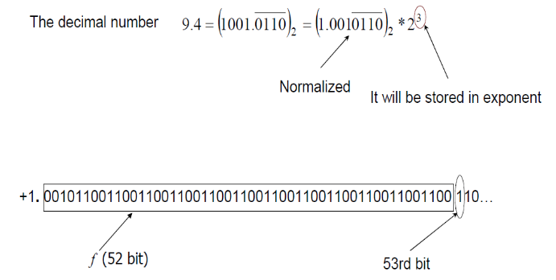
Approximation & Error
Floating Point Arithmetic
How to fit infinite binary number representing 9.4 in a finite number of bits?
CSE 214: Numerical Methods Sessional

Slide 28
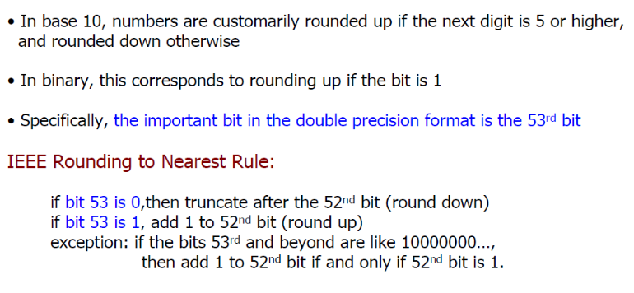
Approximation & Error
Rounding
CSE 214: Numerical Methods Sessional

Slide 29
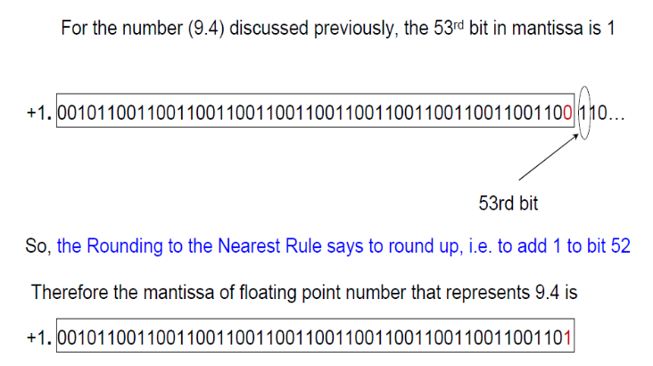
Approximation & Error
Rounding
CSE 214: Numerical Methods Sessional

Slide 30
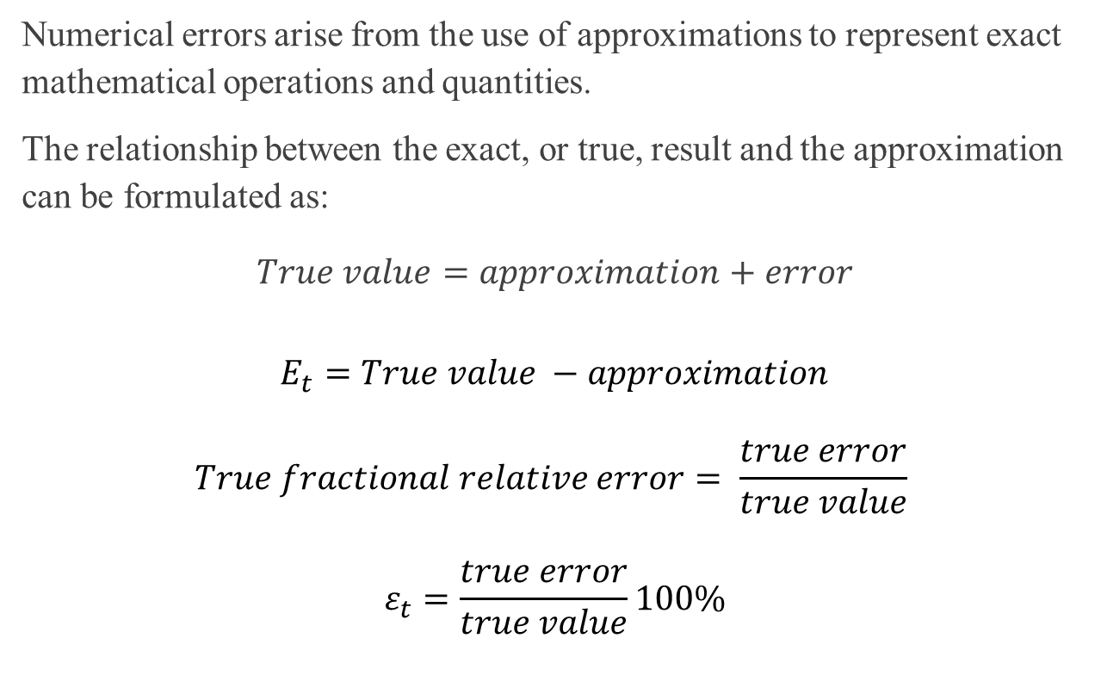
Error Definition
Numerical errors arise from the use of approximations to represent exact mathematical operations and quantities.
The relationship between the exact, or true, result and the approximation can be formulated as:
$$True value=approximation+error$$
$$E_{t}=True value −approximation$$
$$True fractional relative error= \frac{true error}{true value}$$
$$ε_{t}=\frac{true error}{true value}100\%$$
CSE 214: Numerical Methods Sessional

Slide 31
Error Example
For example, we want to measure the length of bridge and a rivet. We measured the length of bridge is 9999 cm and the length of the rivet is 9 cm. The exact values are 10000 and 10 cm, respectively.
The absolute error for both cases is 1 cm.
The percentage relative errors are 0.01% and 10%
CSE 214: Numerical Methods Sessional

Slide 32
Sources of Errors
Errors in Mathematical Modeling
Errors in Numerical Input
Machine Error
Rounding and Chopping
Arithmetic Operations
Inherent Error = Errors in Mathematical Model + Errors in Numerical Input+ Machine Error
CSE 214: Numerical Methods Sessional

Slide 33
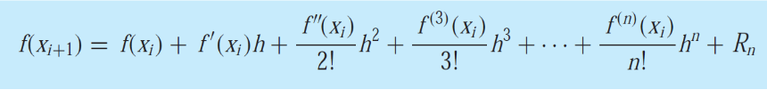
Sources of Errors
Blunders
Blunders are errors that are caused due to human imperfection.
Selecting a wrong numerical method for solving the mathematical model.
Selecting a wrong algorithm for implementing the numerical method.
Making mistakes in the computer programming (coding).
Truncation Errors
Truncation error results from terminating after a finite number of terms known as formula truncation error or simply truncation error.
CSE 214: Numerical Methods Sessional

